Slide 1

RFM Customer Segmentation & Cohort Analysis Project
Capstone project – 1
G12
Team Members
D1113 – Goksel
D1124 – Yusuf
D1125 – B. Zeynep
D1142 – Gulay
D1307 – Emine
D1659 – Tevfik

Slide 2


RFM Customer Segmentation & Cohort Analysis Project
PURPOSE
Developing the company's sales policies and Contributing to the correct use of resources…
RFM Customer Segmentation & Cohort Analysis
Notes:
Elimizde UK tabanli, depose olmayan ve online siparis uzeriden urun satan bir magaza bilgileri bulunmakta. Bu magaza, genellikle unique hediyelik esyalar satmakta ve urun satin alan kullanicilarin cogu toptanci musterilerdir.
Amac, şirketin satış politikalarını geliştirmesine vekaynakların doğru kullanımına katkıda bulunmak.
This is a transnational data set which contains all the transactions occurring between 01/12/2010 and 09/12/2011 for a UK-based and registered non-store online retail. The company mainly sells unique all-occasion gifts. Many customers of the company are wholesalers.

Slide 3

Project Structure
TASKS
Data Cleaning & Exploratory Data Analysis
RFM Analysis
Customer Segmentation with RFM Scores
Applying K-Means Clustering
Create Cohort and Conduct Cohort Analysis
RFM Customer Segmentation & Cohort Analysis

Slide 4




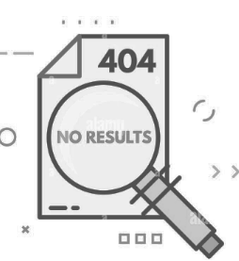
Data Cleaning & Exploratory Data Analysis
ANALYSING DATASET
DATAFRAME
InvoiceNo
StockCode
Description
Quantity
InvoiceDate
UnitePrice
CustomerID
Country
Column: 8
Row: 541,909
Order Quantity
(for each product)
541,909
Duplicate Row Numbers
5,268
Between
2010-12-01 and 2011-12-09
Missing Values
…..
RFM Customer Segmentation & Cohort Analysis
Notes:
Her satir, satilan 1 urun hakkinda bilgi veriyor. Ben dataframemie bakarak O urunun invoice numarasi ne? Description yani urunum ne? Ne zaman siparis verilmis? Customer bilgisi nedir? O urune ait unique stok kodu, siparis icerisinde kac adet urun satilmis, birim basina fiyatim ne ve hangi ulkeden siparis verilmis ogrenebiliyorum.
Her urunun ayri ayri incelendigi toplamda 542bin adet siparis bilgim var. yaklasik 13aylik bir siparis sureci hakkinda detayli bilgi veriyor.
Sadece satin alinan degil, siparisi iptal edilen urunler hakkinda da bilgi edinebiliyorum.
Datami inceledigimde duplice satirlari ve missing valuelariminin oldugunu gordum. Daha detayli olarak anlatmak gerekirse…

Slide 5

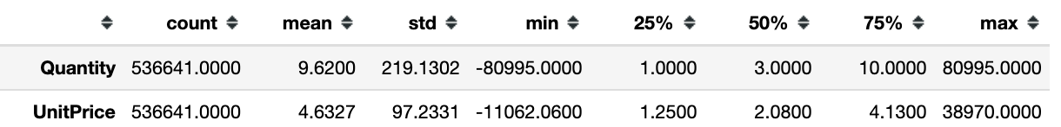





Data Cleaning & Exploratory Data Analysis
Quantity
Max: 80,995
Mean: 9 ?
Negative Unit Prices
Negative Quantities
Cancelled Invoices
i. InvoiceNo, Quantity and UnitPrice columns
ii. "C" in the InvoiceNo
iii. Handling Missing Values
iv. Clean the Data from the Noise and Missing Values
CustomerID
- guest -
Description
RFM Customer Segmentation & Cohort Analysis
Notes:
her bir urun satisina ait bilgileri listeliyoruz. Ben bir siparis icinde en fazla veya en az, hatta ortalama ne kadar satis olduguna bakabilirim
Satis miktarini siparis bazinda inceledigimde tek kalemde en yuksek siparis miktarimi yaklasik 81bin goruyorum,
Ortalama satis adedini inceledigimde siparislerde ortalama 9 birimlik satis yapildigini goruyorum demekki genel olarak siparis basina dusen satis miktarim cok dusuk, maks degerim burada outlier
Ayrica eksi degerlerim oldugunu goruyorum hem satis adedinde hem de birim satis fiyatimda. Bunlar benim iptal edilen siparislerim olabilir.
- Datayi inceledigimde C ile baslayan invoicelarin iptal edilen siparis oldugunu ve negative satis miktarina sahip oldugunu goruyorum
Datamda ayrica eksik bilgiler var, bunlar incognito olarak urun satin alan musteri olabilir. Ayrica urun bilgilerimde de eksik bilgilerim var

Slide 6


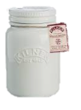


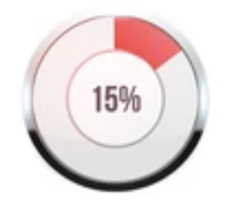

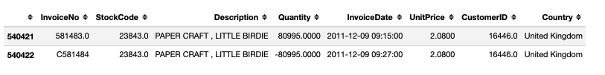
Data Cleaning & Exploratory Data Analysis
v. Explore the Orders
Top-Selling Products
Total Order
Number: 25.900
Cancelled Order
Number : 3.836
RFM Customer Segmentation & Cohort Analysis

Slide 7
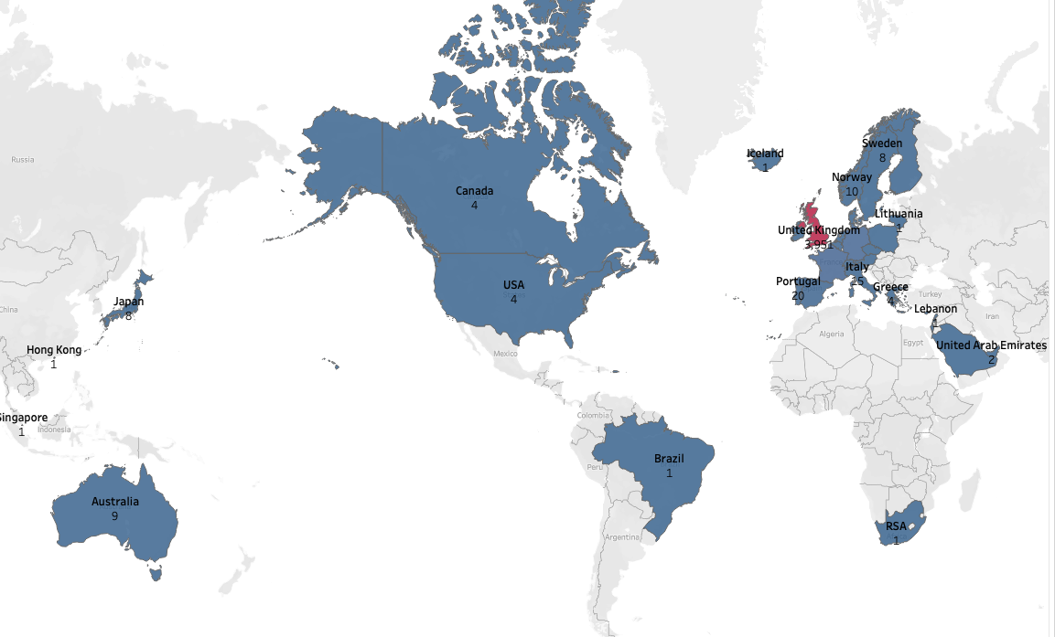
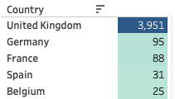
Data Cleaning & Exploratory Data Analysis
vi. Explore Customers by Country
Top 5 country (customer num)
RFM Customer Segmentation & Cohort Analysis
Notes:
After removing duplicate values

Slide 8
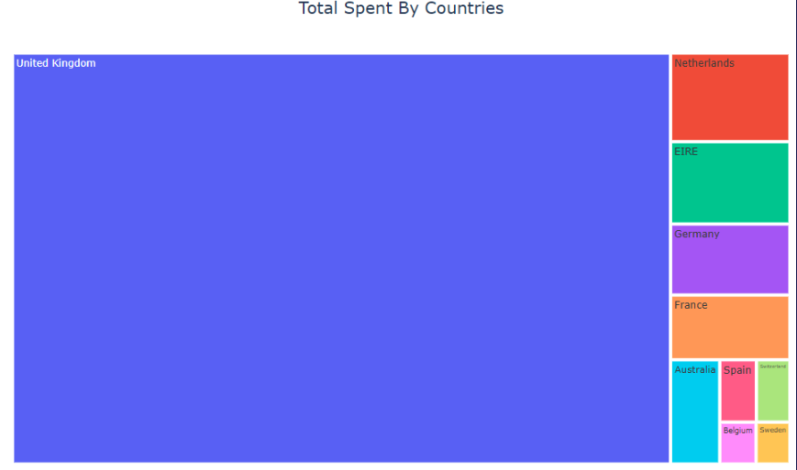
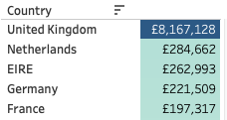
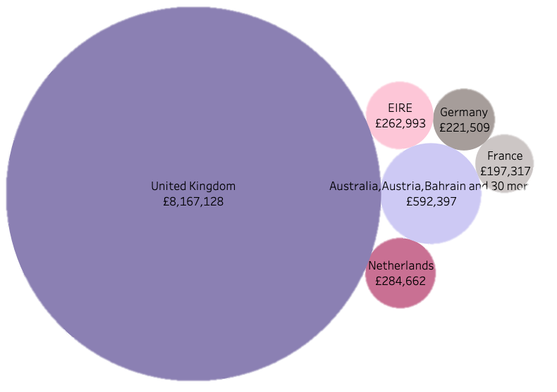
Data Cleaning & Exploratory Data Analysis
vi. Explore Customers by Country
Top 5 country (by revenue)
RFM Customer Segmentation & Cohort Analysis
Notes:
After removing duplicate values

Slide 9

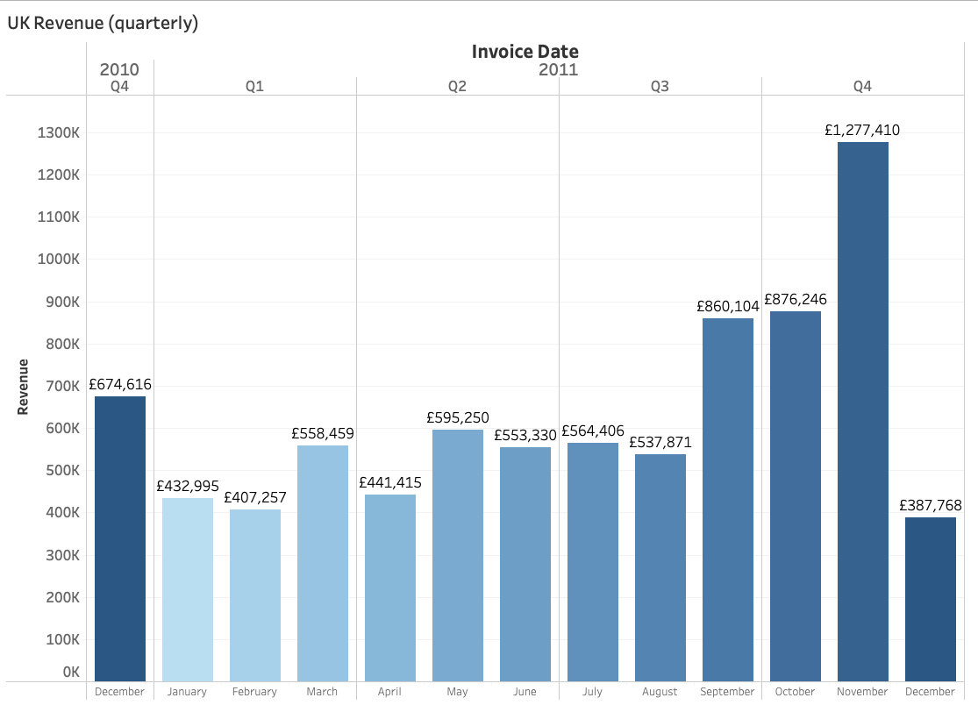
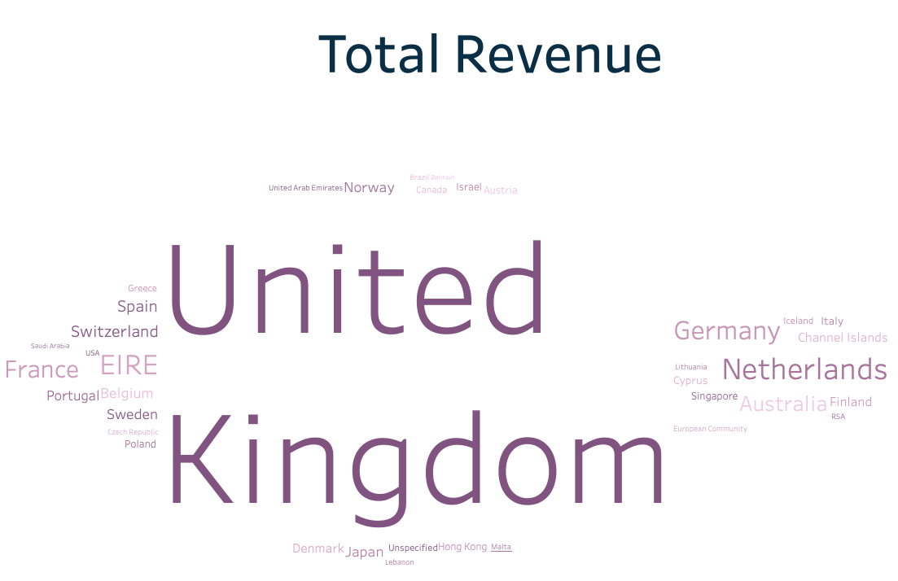


Data Cleaning & Exploratory Data Analysis
vii. Explore the UK Market
First Invoice:
2010-12-01
Last Invoice:
2011-12-09
RFM Customer Segmentation & Cohort Analysis
Notes:
We will continue analyzing the UK transactions with customer segmentation

Slide 10
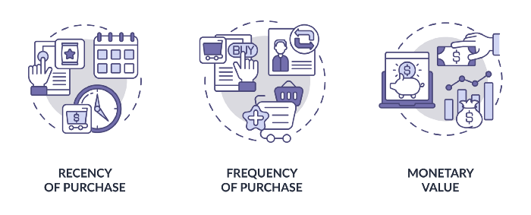
RFM analysis
(recency, frequency, monetary)
RFM Customer Segmentation & Cohort Analysis

Slide 11
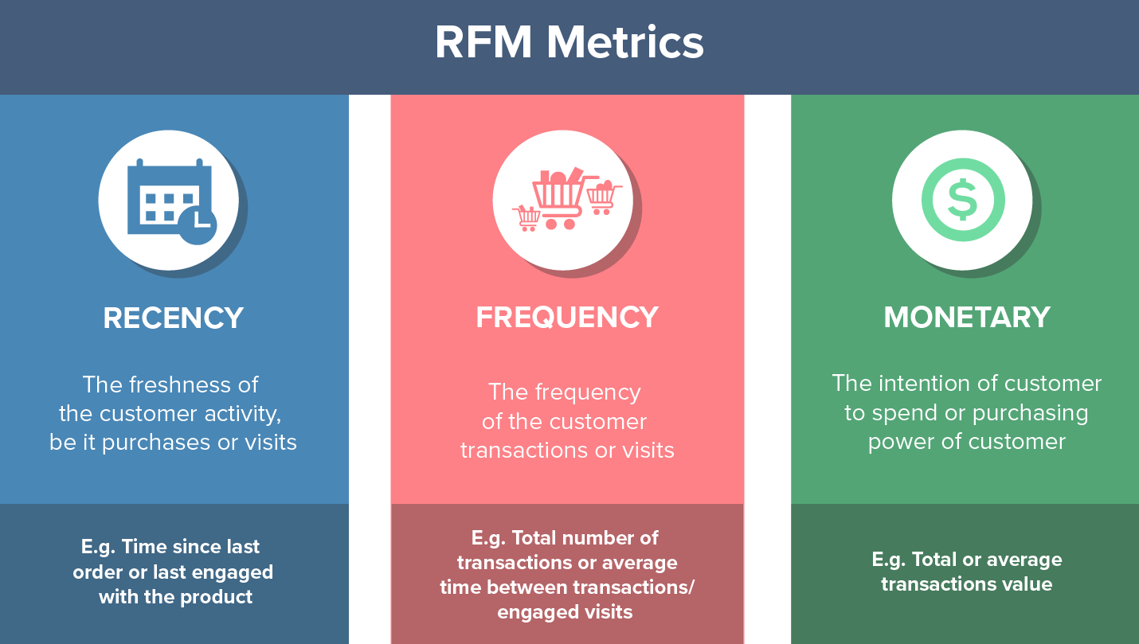
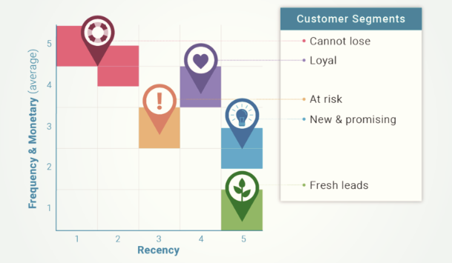
RFM Analysis
RFM Customer Segmentation & Cohort Analysis
Notes:
Musterileri elimizde tutmak icin ne yapmamiz lazim, vs
Datetime import gerekiyor
En cok satis uk oldugu icin df_uk inceliyoruz,
Referans zaman belirleyerek inceleme yapiyoruz, recent_day = en son yapilan islem , biz sadece date’ini aliyoruz
Invoice_date tamamen date’e ceviriyoruz,
= her musterinin en son yaptigi alisverisi aliyoruz,
Musteri bazinda, son yapilan islemle bir onceki islemi arasinda gecen zaman

Slide 12

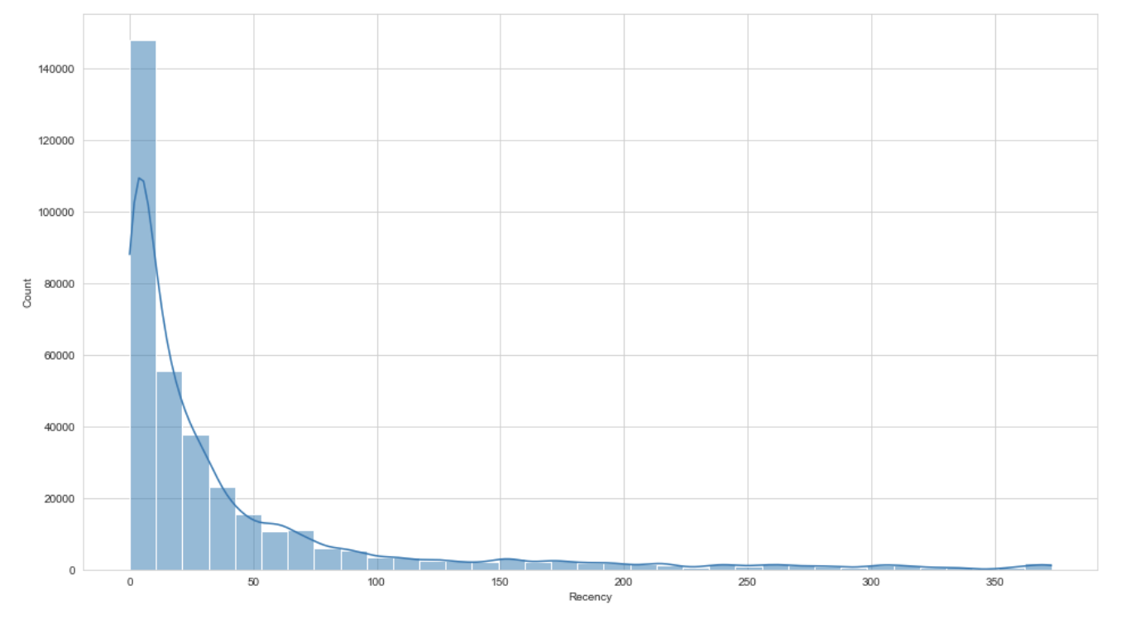
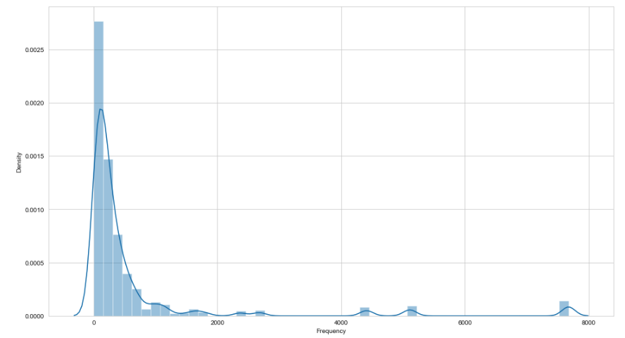
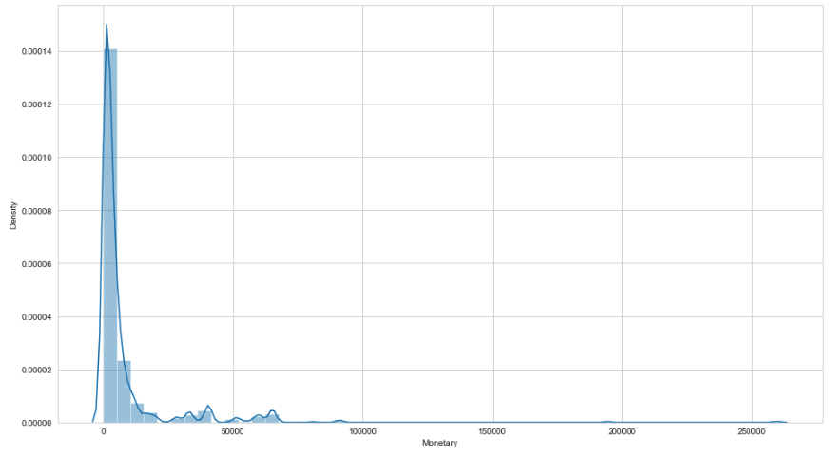
Customer Segmentation with RFM Scores
Recency
- Recent day: '2011-12-09
Frequency
Monetary
Days since last purchase
Number of purchases
Total amount of money spent
RFM Customer Segmentation & Cohort Analysis

Slide 13
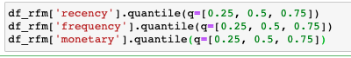
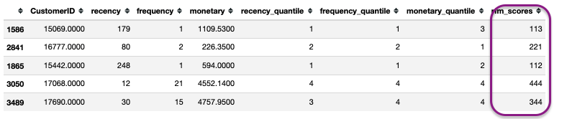
rfm_Scoring
Each column is divided into 4 equal parts
The score value was determined for each column.
Customers are rated from 1 to 4 according to national values
and the scores are combined for segmentation
Rfm_level is defined
A name is set for each segment
Best Customer
Loyal Customer
Big Spenders
Almost Lost Customers
Lost Cheap Customers
RFM Customer Segmentation & Cohort Analysis

Slide 14
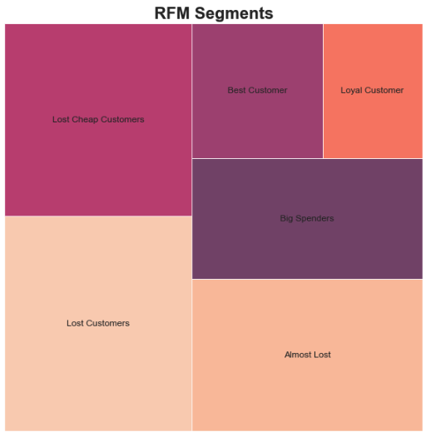
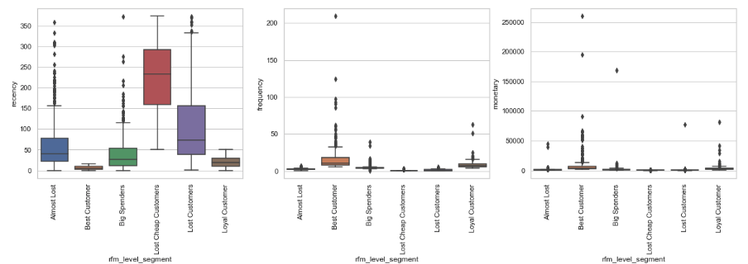
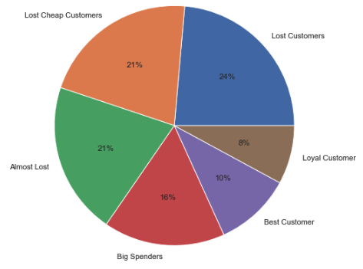
RFM Segments
RFM Customer Segmentation & Cohort Analysis

Slide 15
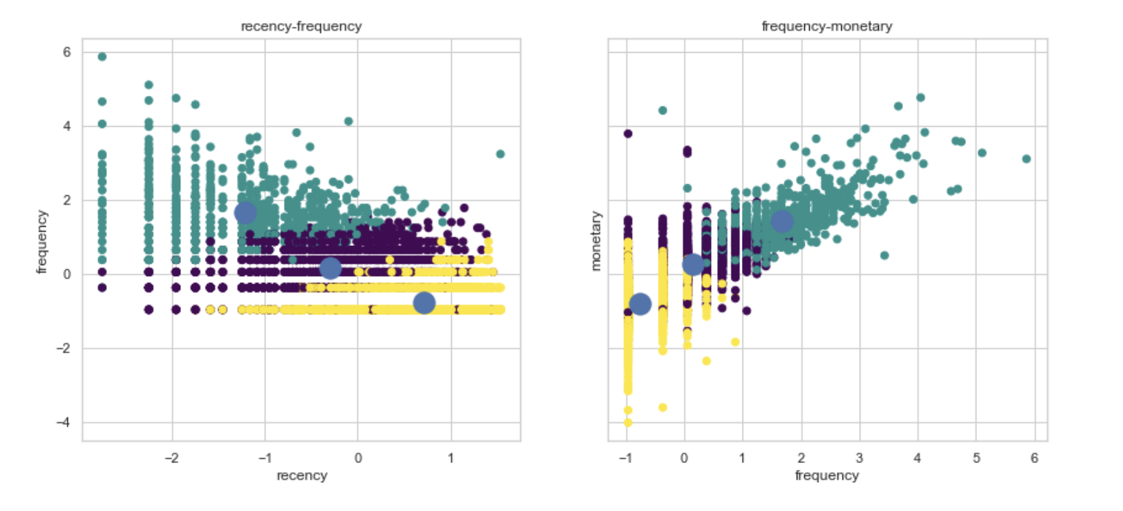
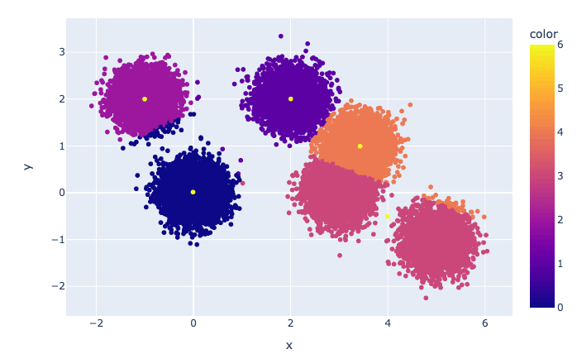
K-Means Clustering
further insight into customer behaviour

Slide 16
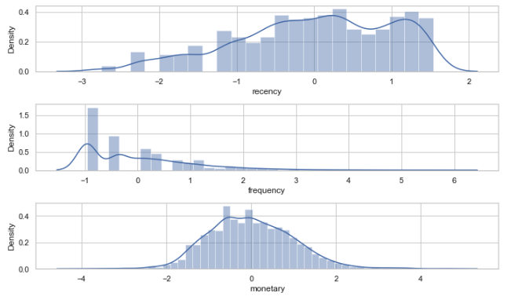
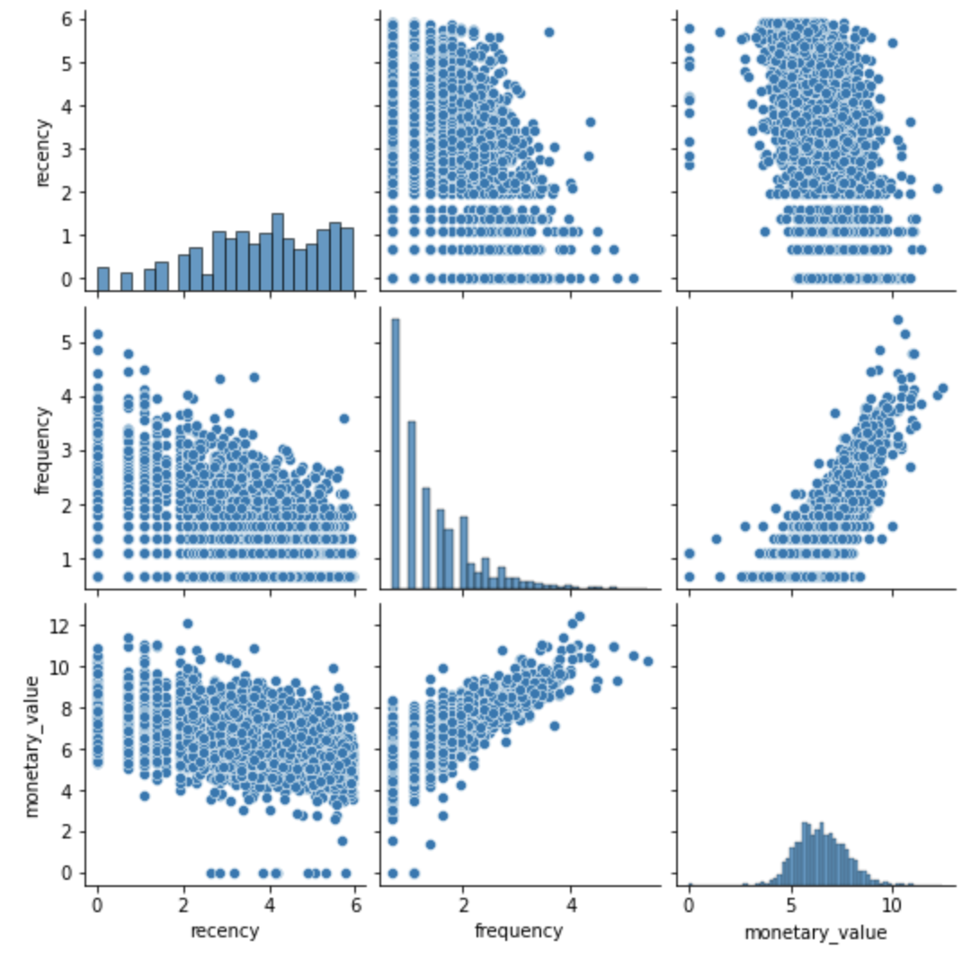
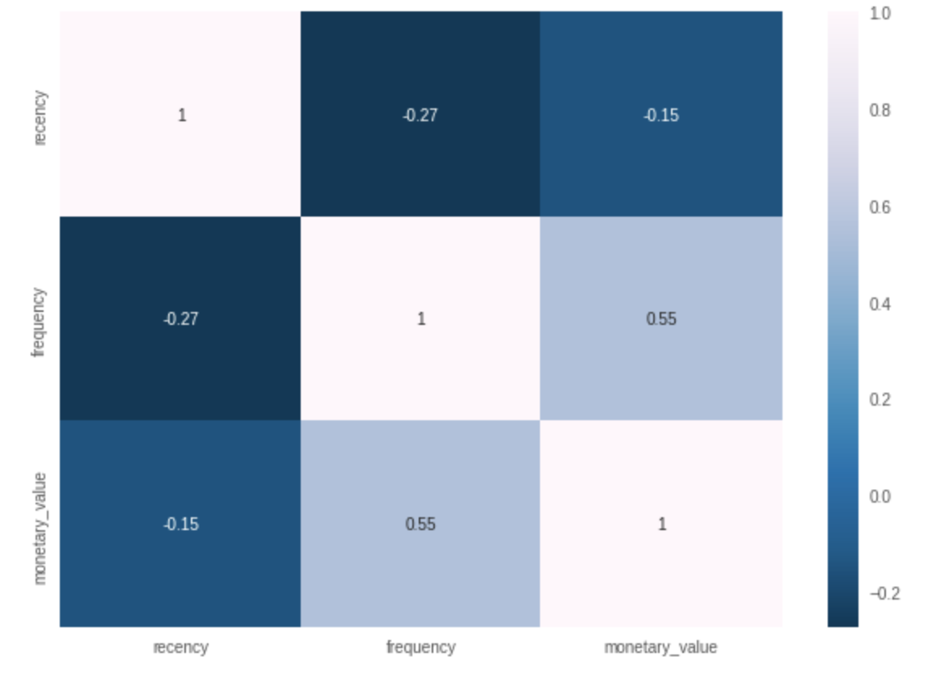
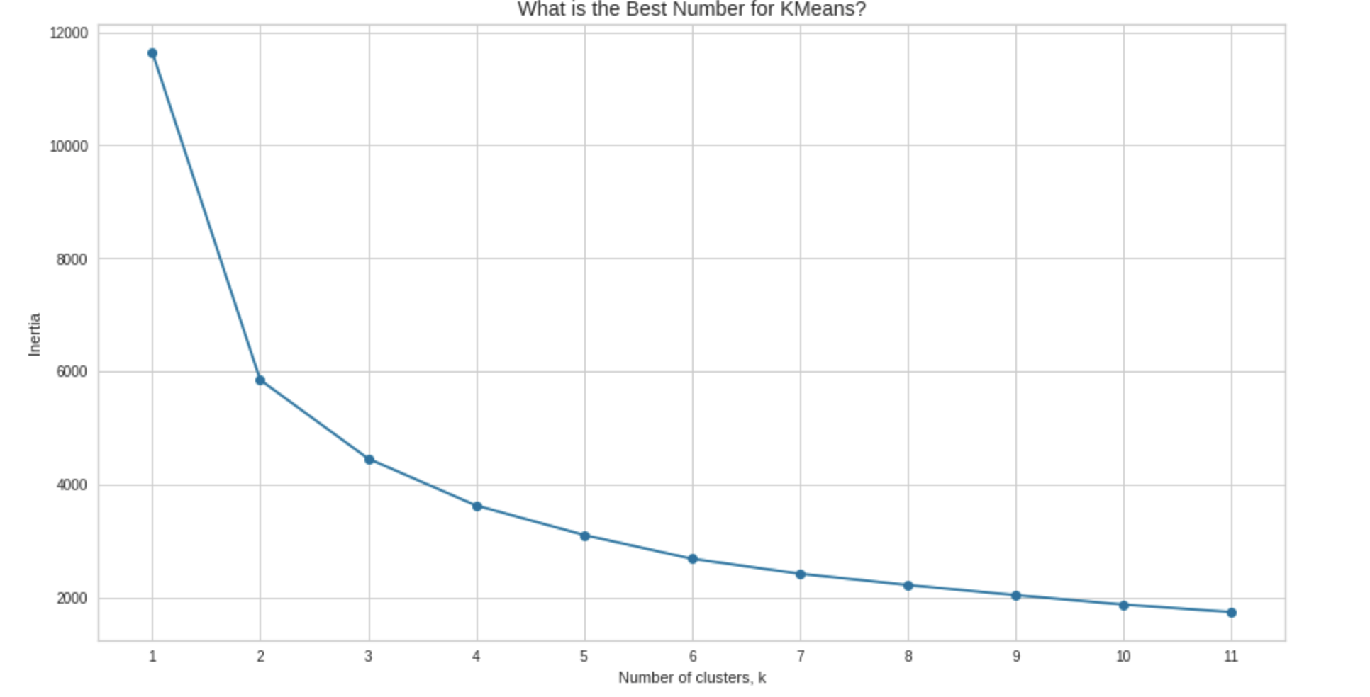
Applying K-Means Clustering
After data normalization
K-Means Implementation
RFM Customer Segmentation & Cohort Analysis

Slide 17
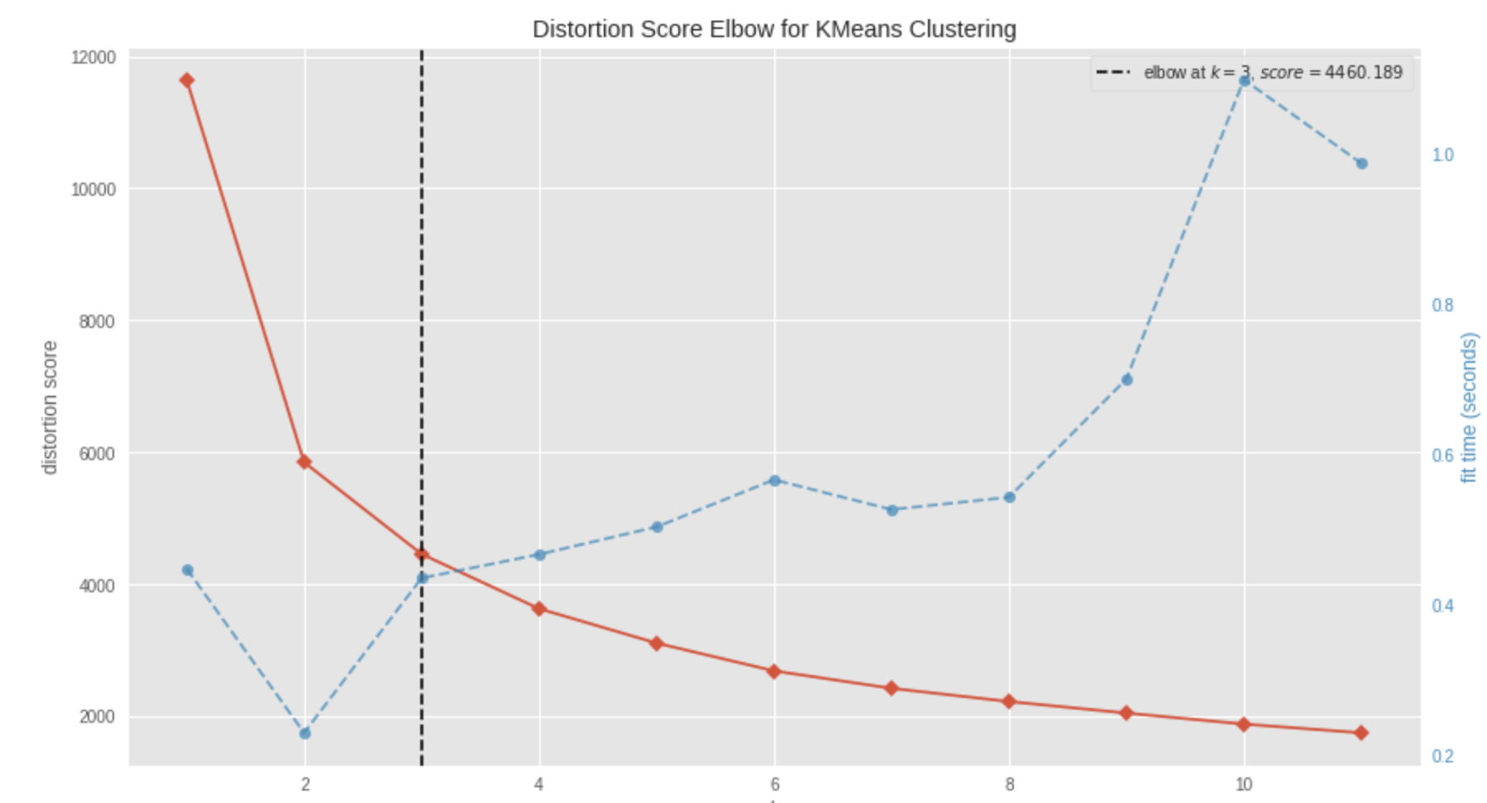
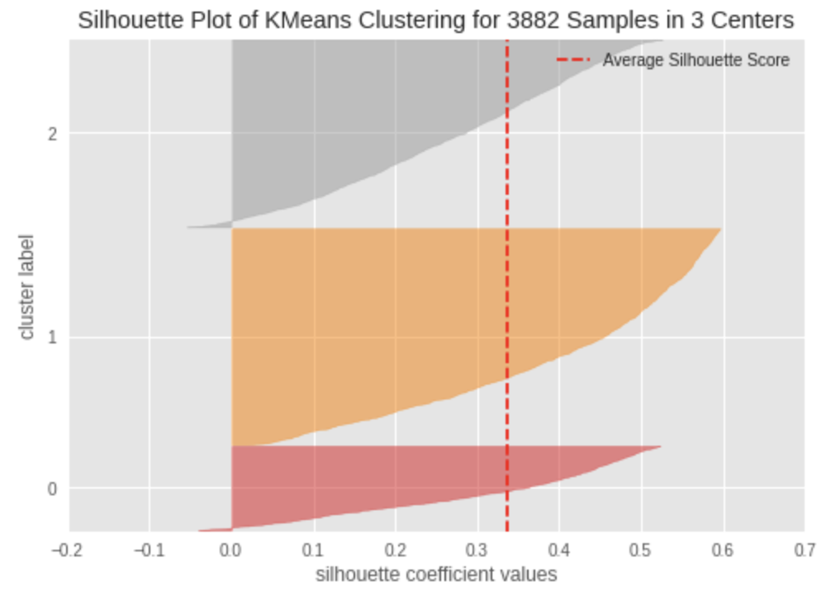
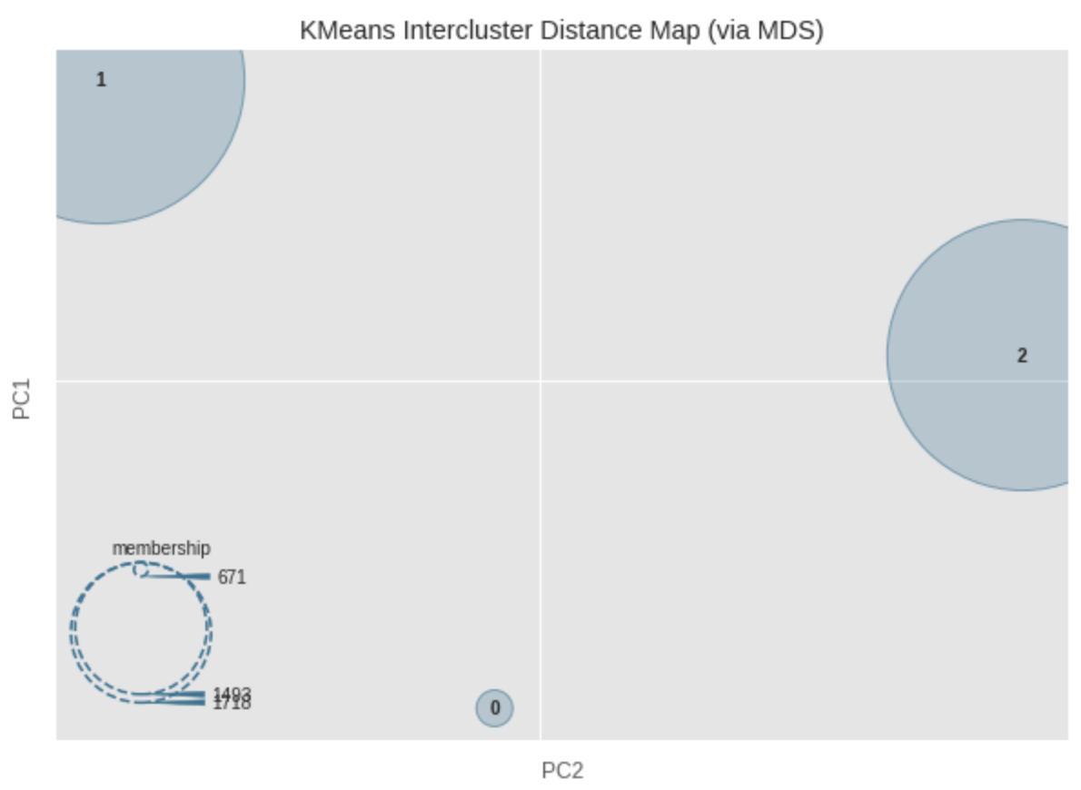
Applying K-Means Clustering
RFM Customer Segmentation & Cohort Analysis

Slide 18
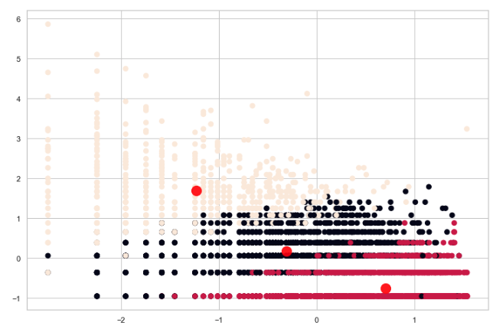
Applying K-Means Clustering
Scatter plot and cluster centers
RFM Customer Segmentation & Cohort Analysis

Slide 19
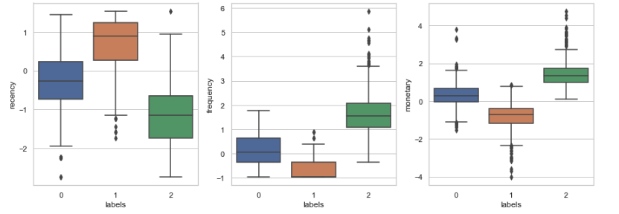
Applying K-Means Clustering
RFM Customer Segmentation & Cohort Analysis

Slide 20
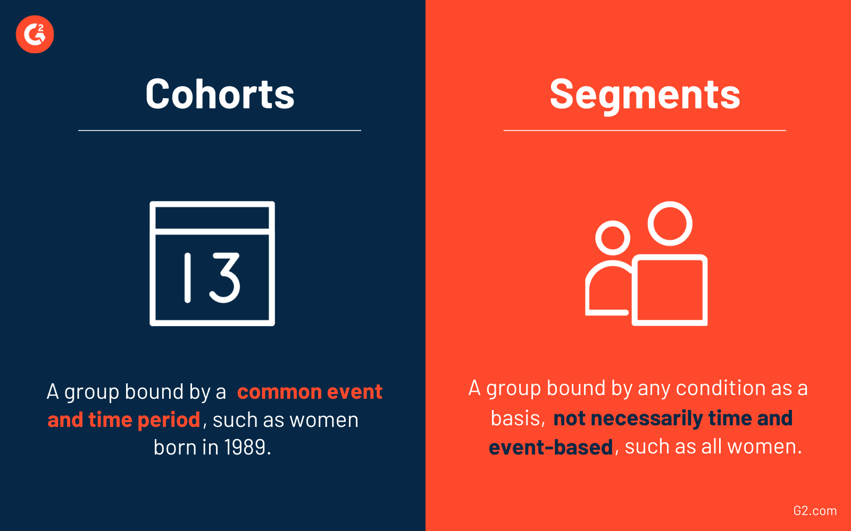
Cohort & Conduct Cohort Analysis
analysing user growth patterns for products
Notes:
Segmentlere ayirma işlemi zamana veya bir olaya bagli değildir, ancak cohortlara ayirma işlemi belirli bir süre araliginda periyodik yapilan işlemlerin gruplandirilarak analiz edilmesidir.
Ornegin butun kadinlar dediğimizde segmente ayirmis oluruz,
2000’den sonra doğan kadinlar dersek belirli zaman araligini incelediğimiz için bu cohort olur.
biz de cohort analizi yaparken sipariş verilerini aylara bölerek inceleyeceğiz.

Slide 21
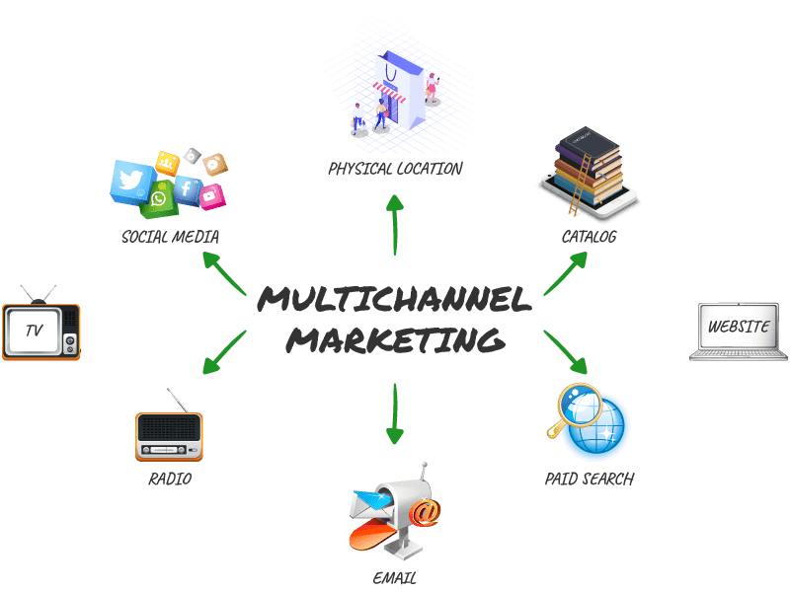


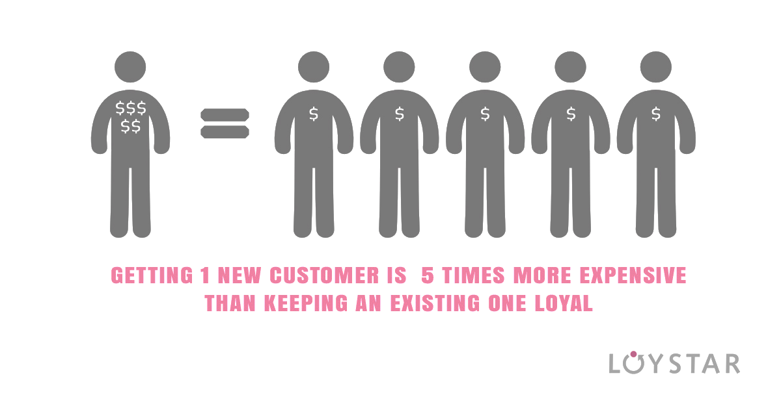

ADVANTAGES Cohort Analysis
How much effective was a marketing campaign held in a particular time period?
Should I focus more on retention
rather than acquiring new customers?
Which marketing channels bring me the best results?
Is there a seasonality pattern in customer behaviour?
RFM Customer Segmentation & Cohort Analysis
Notes:
Cohort analizi yapmanin avantajlari cok fazla.
- Marketing calismasi yaptiysam hangi zaman periyodunda hangi kampanyam daha efektif calismis?
- Hangi kanallardan yaptigim marketing faaliyetleri bende en iyi sonucu vermis
inceleyebilirim.
Ayrica yapilan arastirmalar yeni musterikazanmanin, varolan musterinin devamini saglamaktan 5 kat daha fazla masrafli oldugunu soyler.
cohort analizim, datama bagli olarak yeni musteriler mi kazanmaliyim yoksa varolani mi surdurmeliyim konusunda bana fikir verir.
- Periyodik olarak inceledigimiz icin periyotlar arasinda bir pattern olup olmadigini da analiz sonrasinda gozlemleyebiliriz.

Slide 22
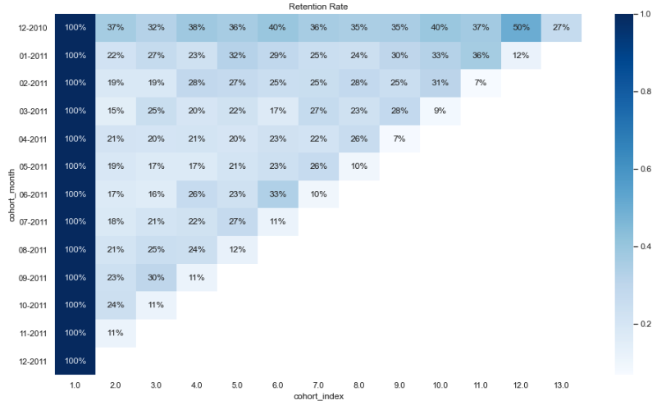




Monthly Cohort Analysis
Cohort Table for Retention Rate in Percentage – Monthly Cohorts
Retention
over user lifetime
Customer ID
Price/Revenue
Quantity
Date-Range
Number of unique customers are calculated in each group of cohort date
13 cohorts for each month and 13 cohort indexes.
Sample:
06-2011 cohort_month in 6th Cohort Index,
* 33% of cohorts that signed in Jun 2011 were active 6 months later.
% of users retained
1 month after first session
cohort_index
Order of month in given time range
RFM Customer Segmentation & Cohort Analysis
Notes:
Elimizdeki musteri, kazanc, satis miktari, zaman periyodu verileri mevcut
Aralik'10'dan aralik'11'e kadar 13 aylik bir periyodum mevcut.
Y eksenim aylari, X eksenim aylarin indexini, periyot zamanini gosterir
1.ay sonra 2 ay sonra gibi.
Retention rate ise devam eden musterilerimin orani.
→ Ornek verecek olursam, buradaki %33
2011 haziran ayinda baslayan mustelerimin
6 ay sonra %33’u devam etmis
We have 13 cohorts for each month and 13 cohort indexes. The darker the blue shades higher the values. Thus, if we see in 2011-06 cohort Month in 6th Cohort Index, we see the dark blue shade with 33% which means that 33% of cohorts that signed in Jun 2011 were active 6 months later.

Slide 23
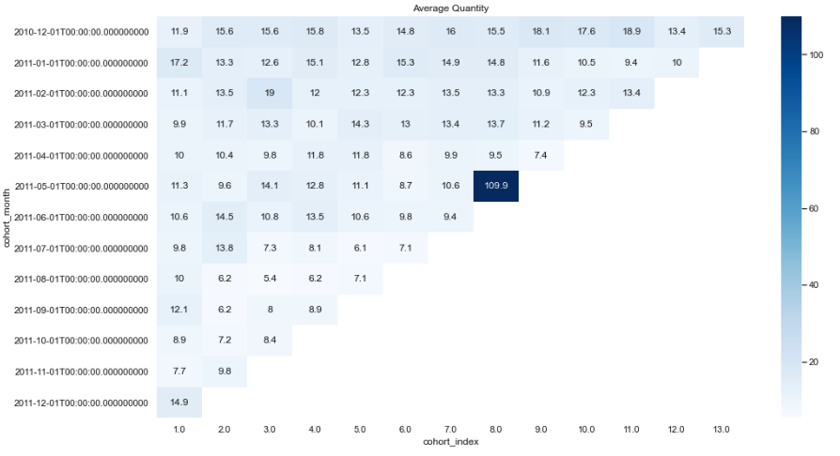
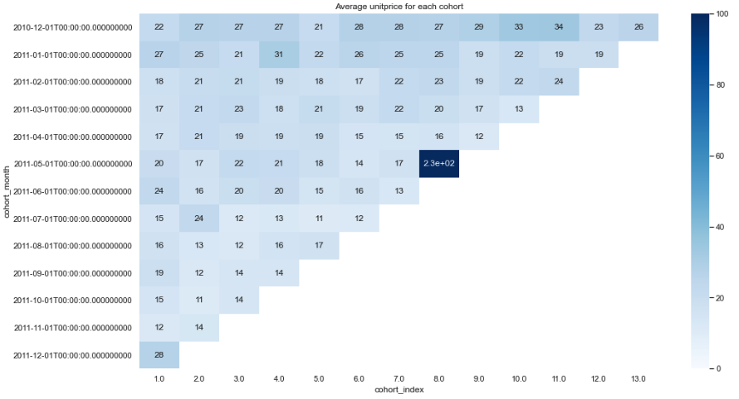
Monthly Cohort Analysis
Average Quantity Sold
Average Sales Amount
RFM Customer Segmentation & Cohort Analysis
Notes:
Satislarimda ortalama kac urun satiyorum veya ortalama satis miktarimdaki degisimi cohort analizi ile gorup degerlendirebilirim.
Koyu olan bir satir elde etmis olsaydim o tarihte baslayan musterilerimde ortalama urun adedi sayisinin veya satis miktarinin daha yuksek oldugunu soyleyebilirdim.

Slide 24




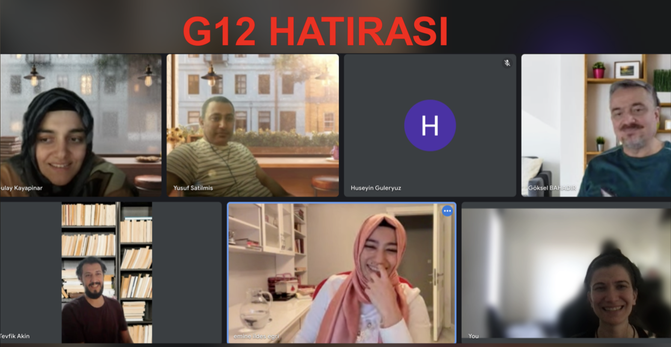
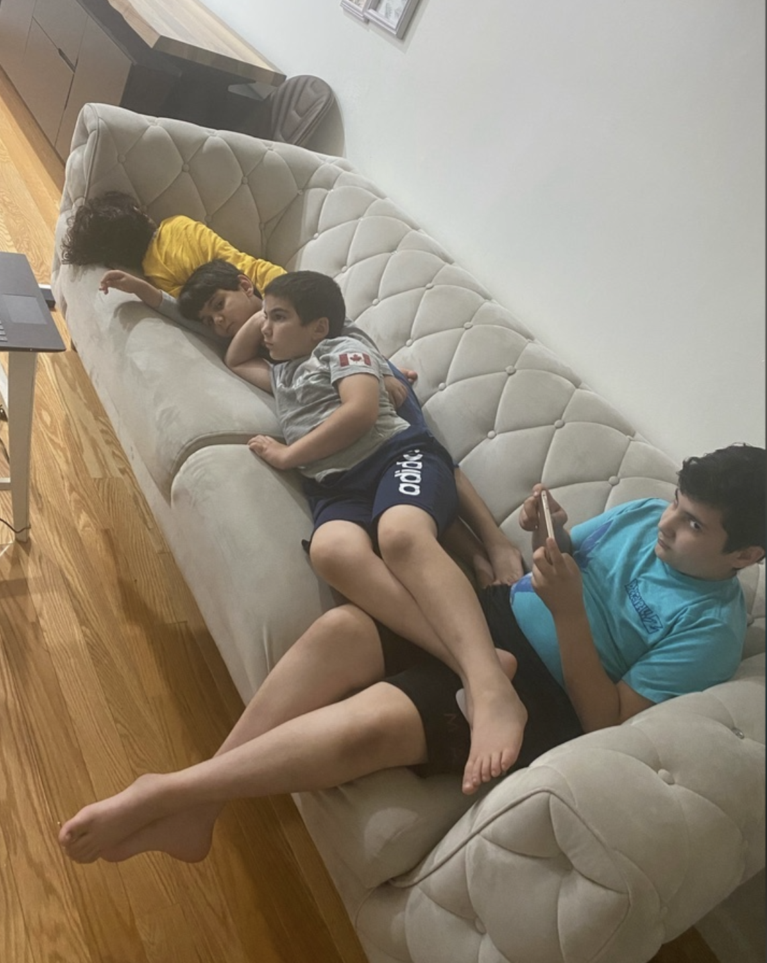
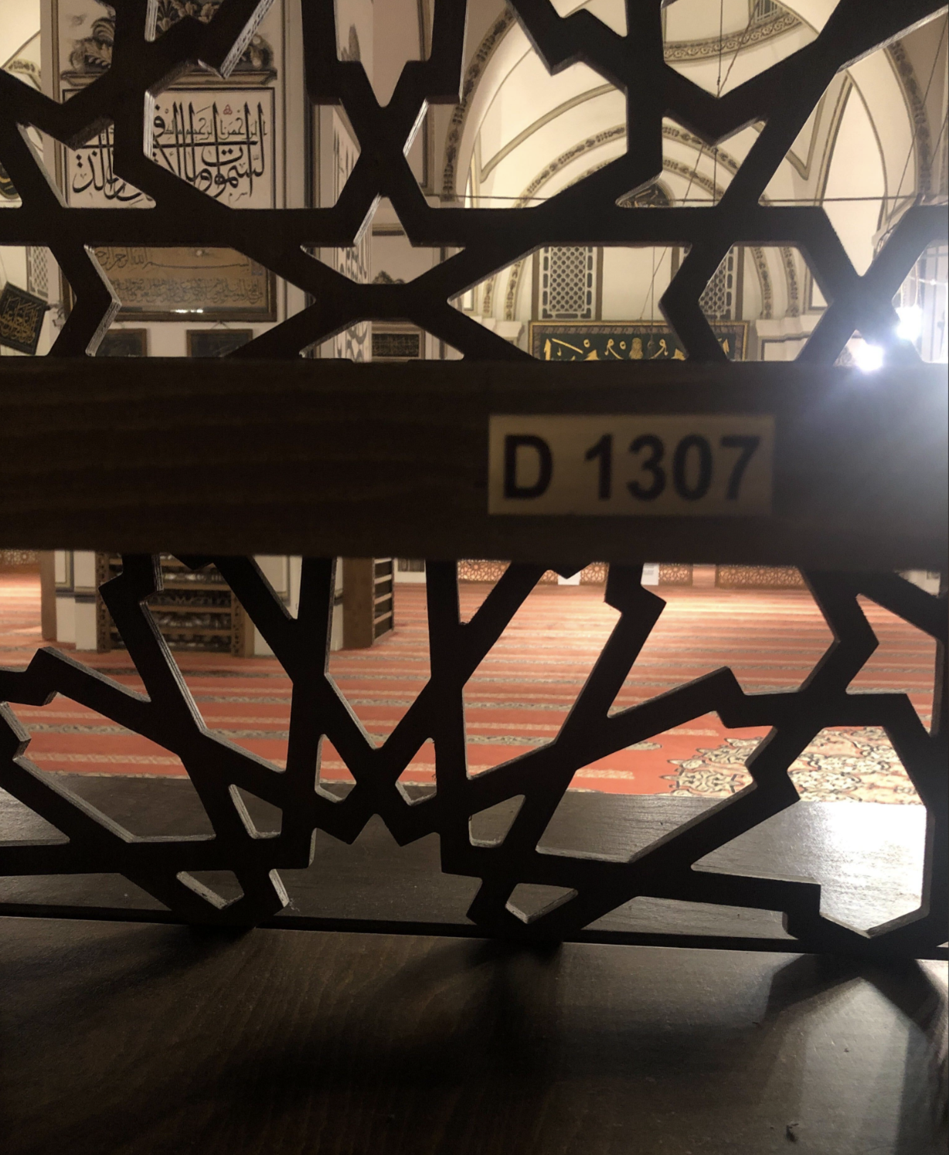
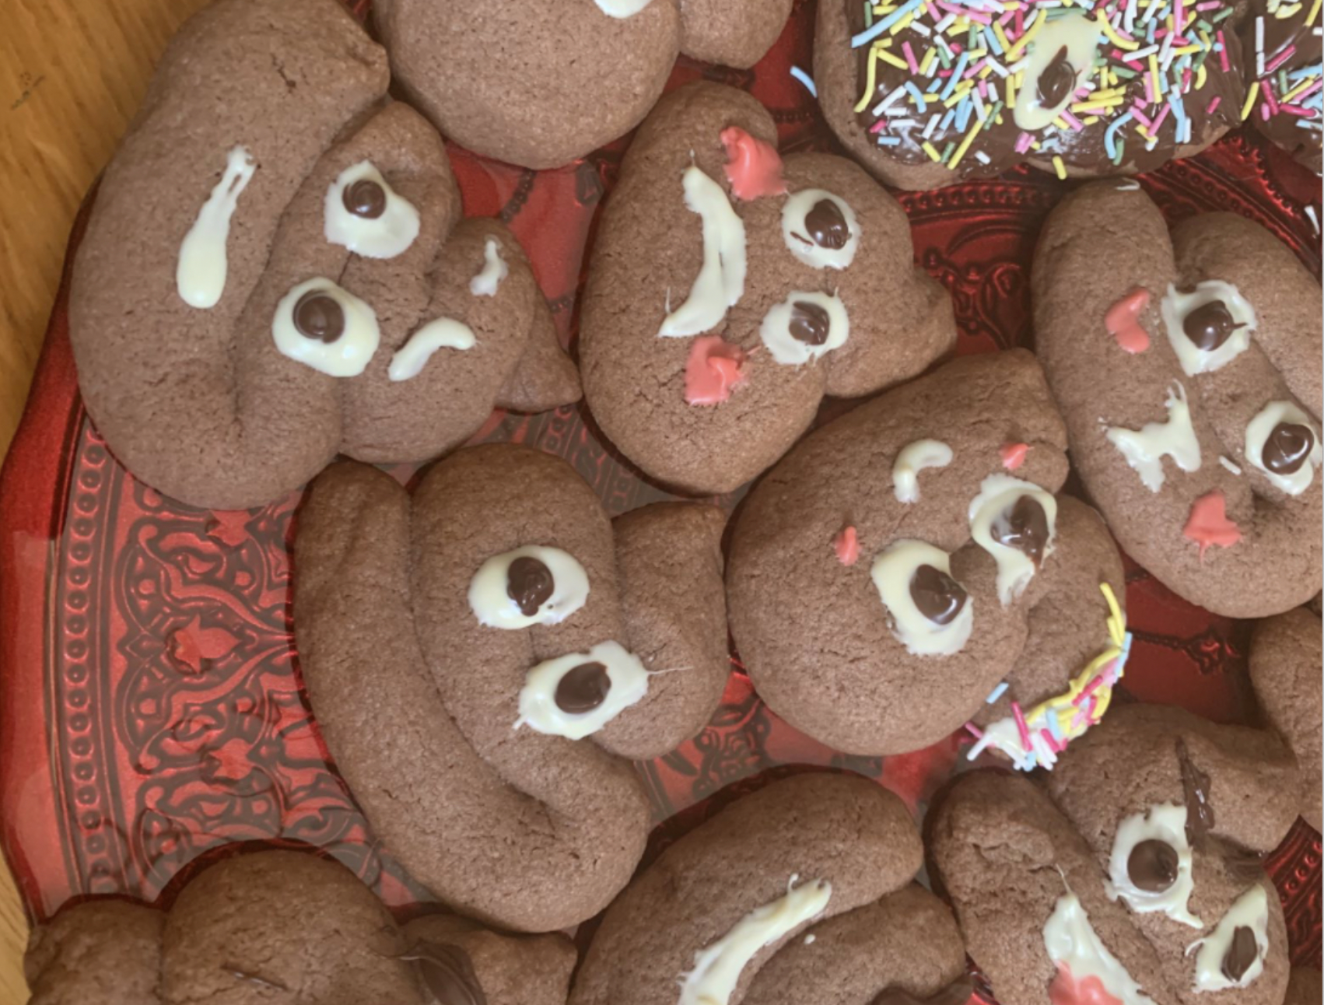
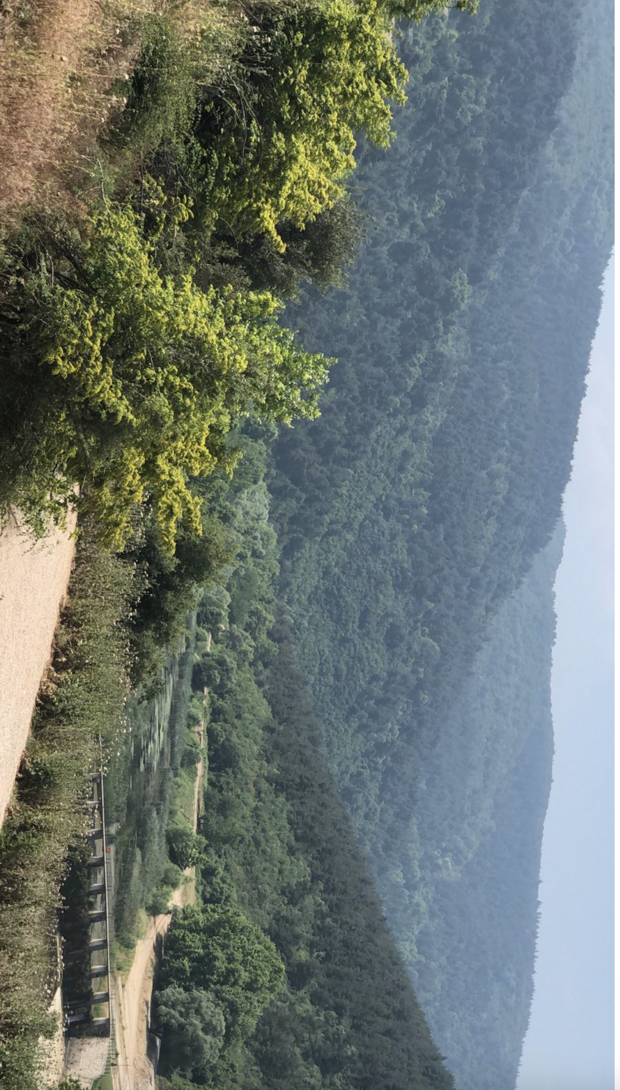

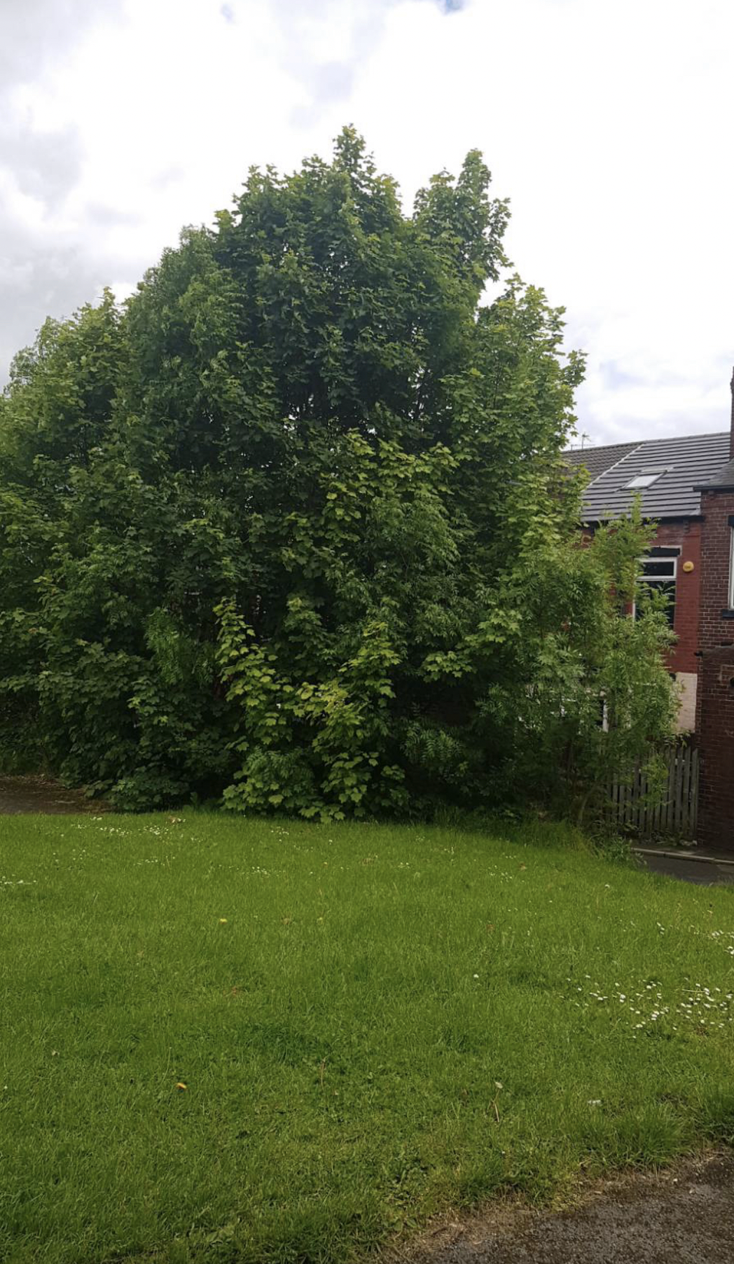
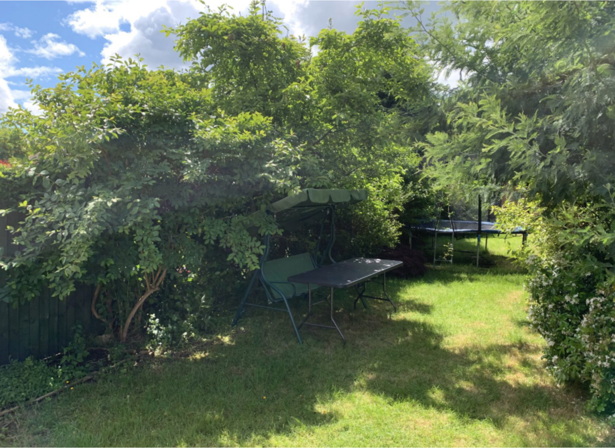


Thank you for listening…
Londra
Leeds
Birmingham
Manchester
New Jersey
Bursa

